Slide 1
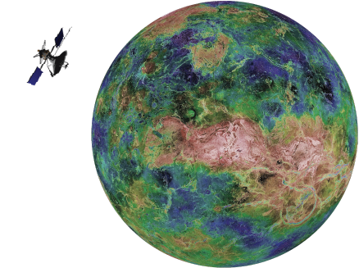
Gravitational Indications of Subduction on Venus
By: Rudger Dame

Slide 2
Background: Missions to Venus
Venera and Vega (1961-1983)
A series(1-16) of Soviet missions
Probe, lander and/or orbiter
Pioneer Venus (1978-1992)
Orbiter that characterized the atmosphere and surface
4 probes landed on the surface
Magellan (1989-1994)
-Synthetic Aperture Radar(SAR) and obtained near global radar images
-Obtained near global topography with 50km spatial and 100m vertical resolution.
Future Missions: VERITAS, EnVision, and DAVINCI
-VERITAS and EnVision missions will collect higher resolution radar images, surface emissivity and improve the gravity resolution
-DAVINCI mission includes an orbiter and decent probe that will both study the Atmosphere.

Slide 3
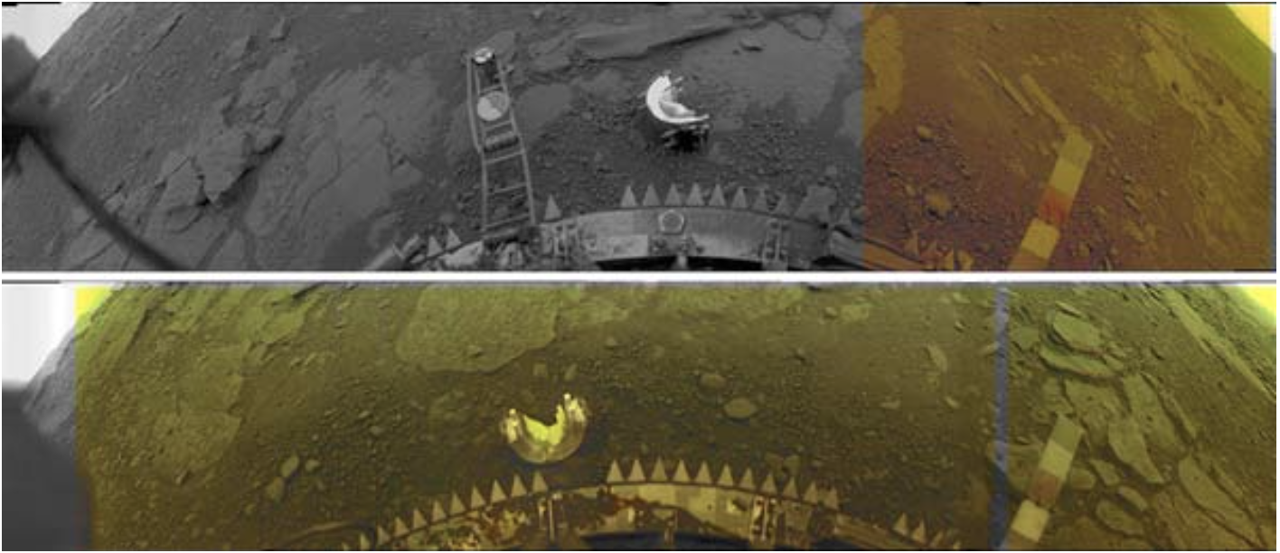
Venus Surface
Surface temperature of ~740 K and a thick 92 bar atmosphere mainly consisting of CO₂ , being the cause for an extreme greenhouse gas effect.
Venera landers recorded surface compositions consistent with basalt.

Slide 4
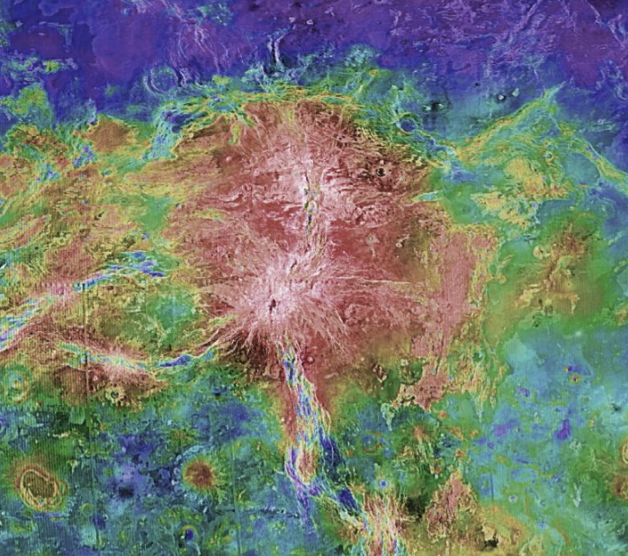
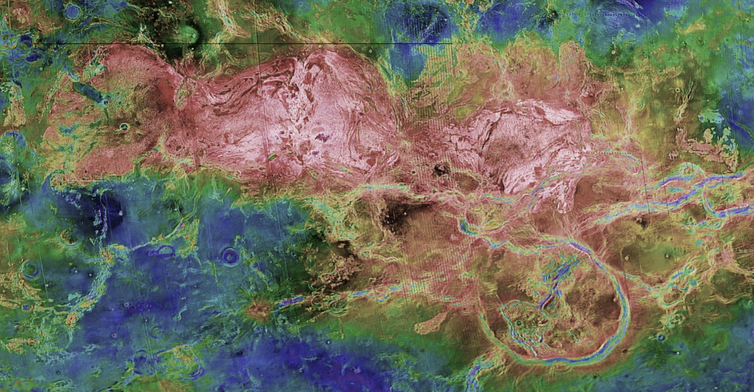
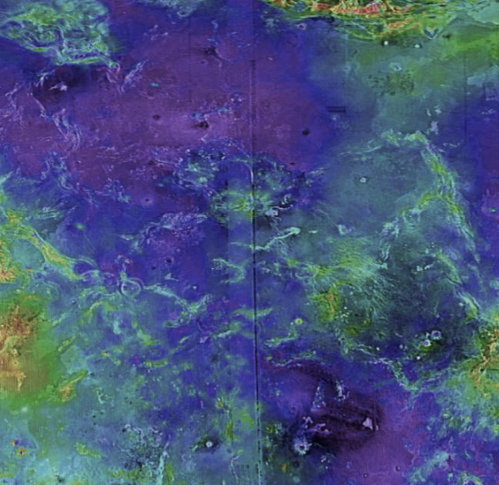
Surface Features
Most of the surface features on Venus can be classified into three different categories:
Volcanic rises
Crustal highlands
Low-lying volcanic plains

Slide 5
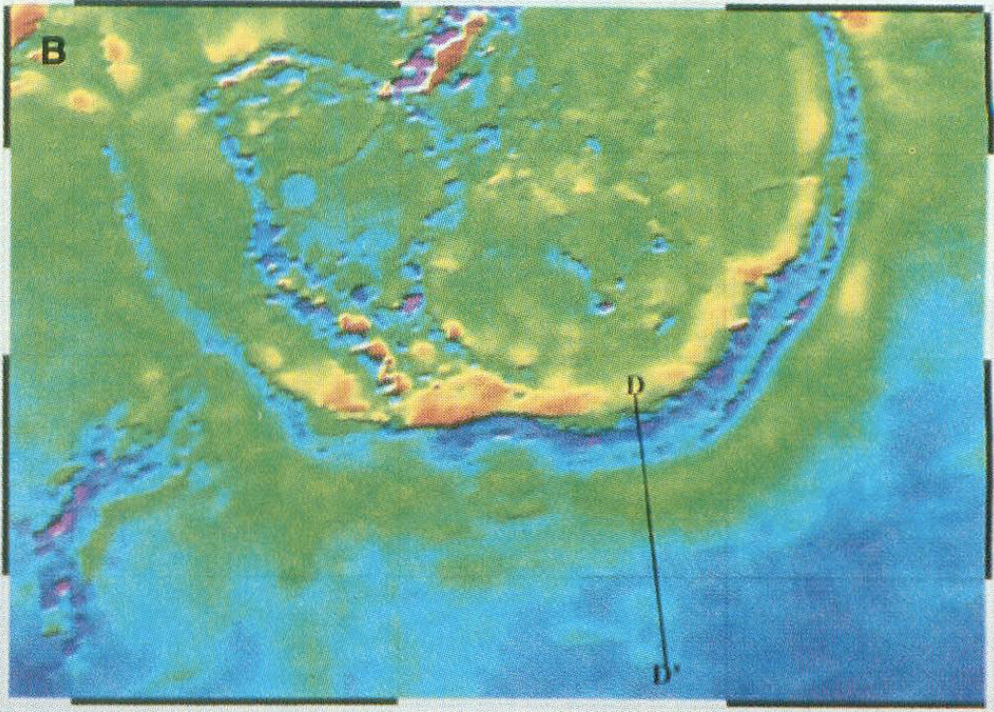
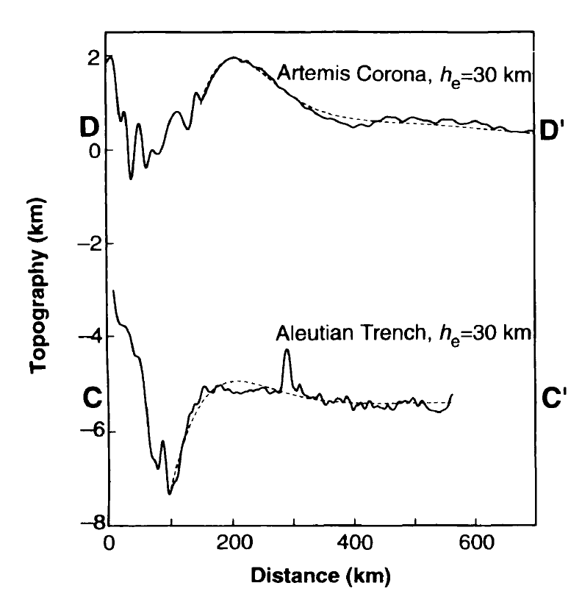
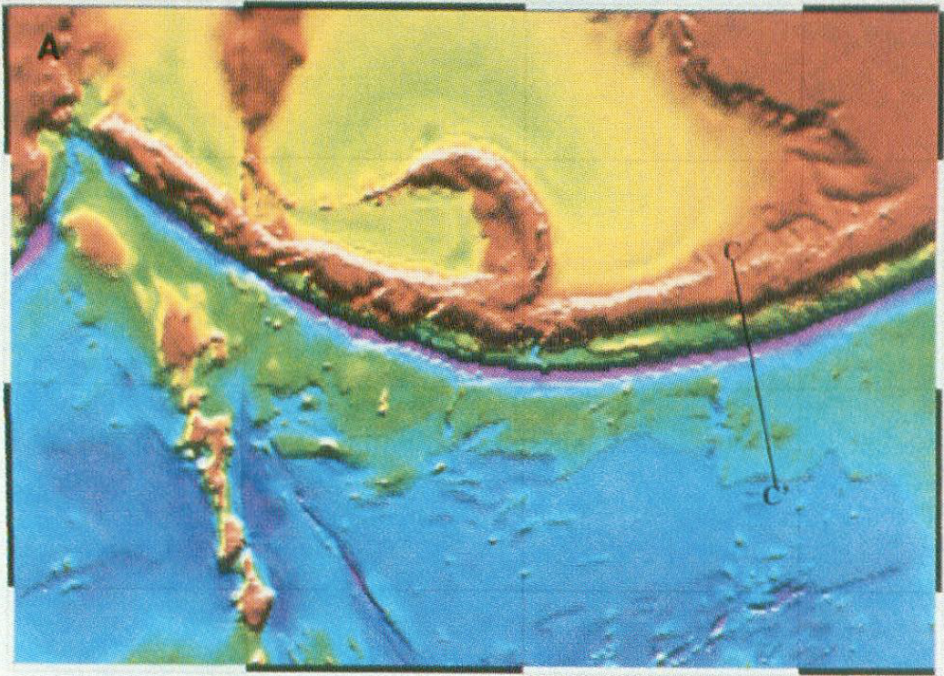
Features similar to Terrestrial Subduction
Overriding Plate
Outboard Plate
(Sandwell & Schubert 1992)
Notes:
There has been locations on Venus that are found to be similar to ocean-ocean ...

Slide 6
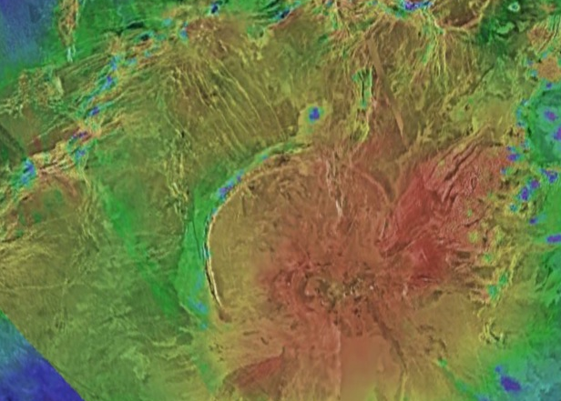
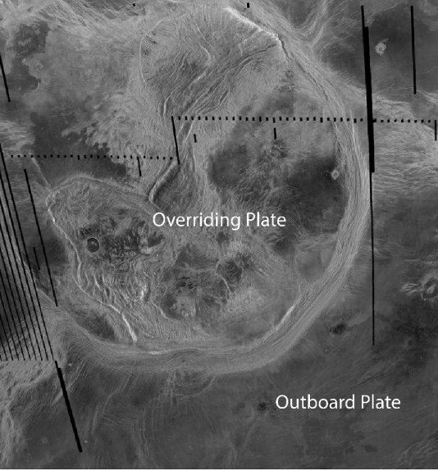
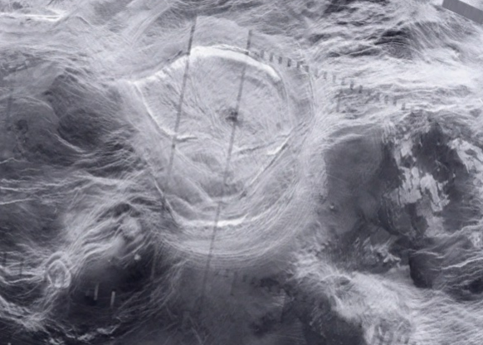
Venusian Subduction: Corona
Outboard Plate
Coronae are quasi-circular tectonic fracture features unique to Venus associated with volcanic activity
Many have been associated with mantle plumes
Ranging in size from 60 to over 2000 km across
Overriding Plate

Slide 7
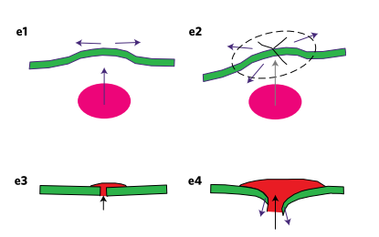
Plume Induced Subduction
(Davaille et al. 2017)
Rising plume weakens the lithosphere and flexes it upwards.
Radial fractures and rifts develop
Volcanic loading occurs on the surface
The broken lithosphere begins to sink under its own weight and the weight of the new material, starting subduction
The trench migrates back as the lithosphere sinks
Notes:
Rising plume weakens the lithosphere and flexes it upwards.
Radial fractures and rifts develop
Volcanic loading occurs on the surface
The broken lithosphere begins to sink under its own weight and the weight of the new material, starting subduction
Due to the circular nature, several slabs are produced along the plume rim
The trench migrates back as the lithosphere sinks
﻿Subduction stops when plume upwelling ceases

Slide 8
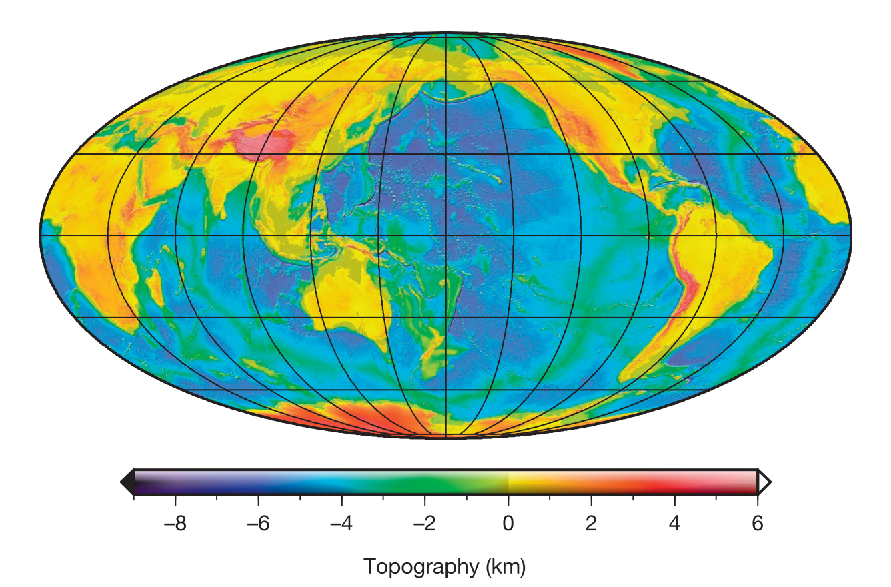
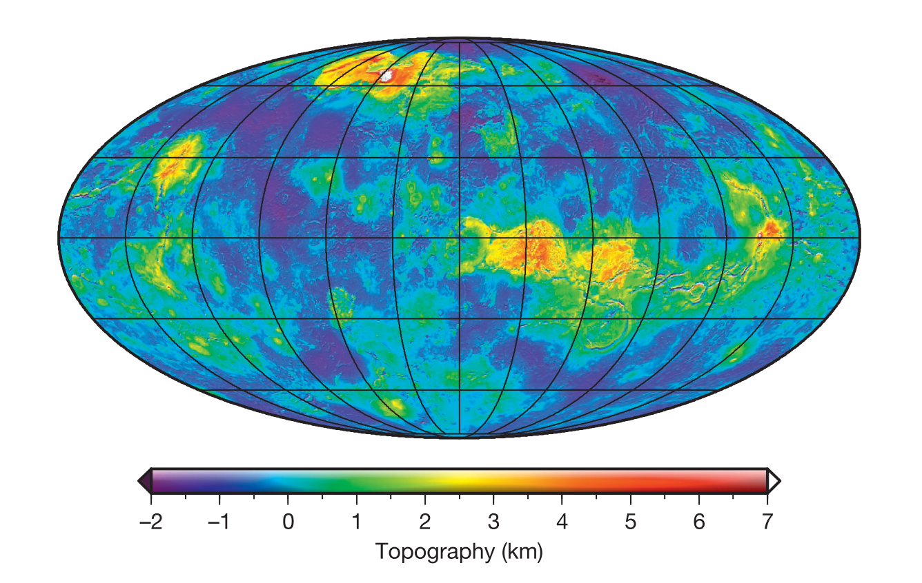
Topography Data sets
(Wieczorek et al., 2015)
Earth: the Shuttle Radar Topography Mission produced the SRTMP2160 dataset. The spatial resolution of this dataset is ~100 m.
Venus: The degree order 719 VenusTopo719 is a spherical harmonic shape model (Wieczorek 2015).

Slide 9
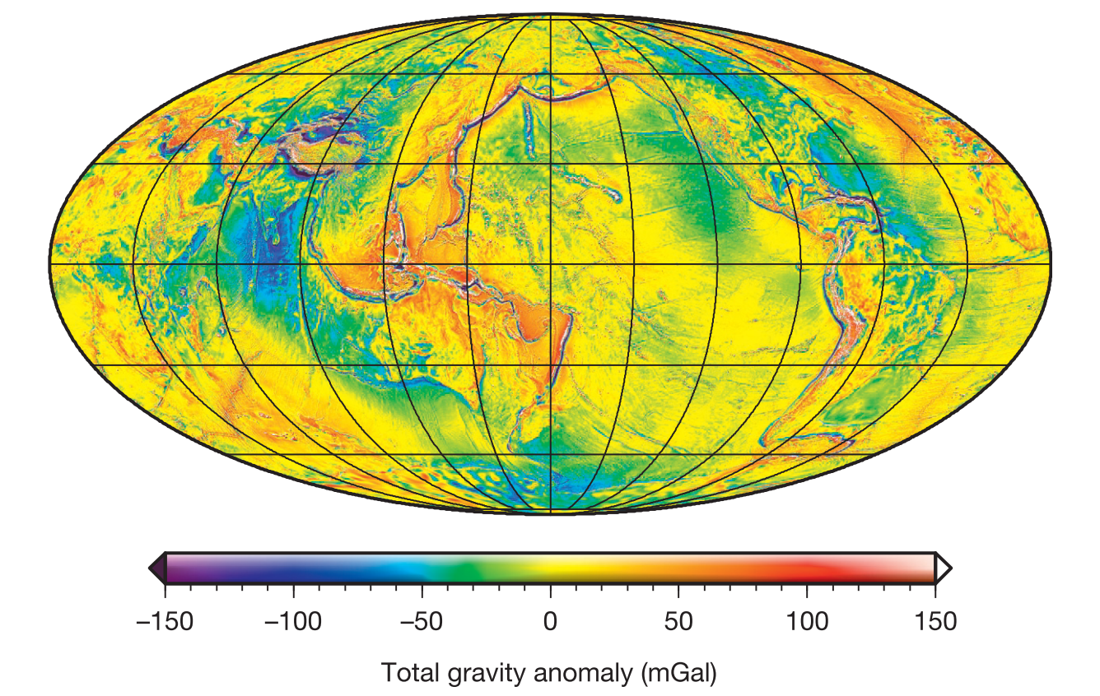
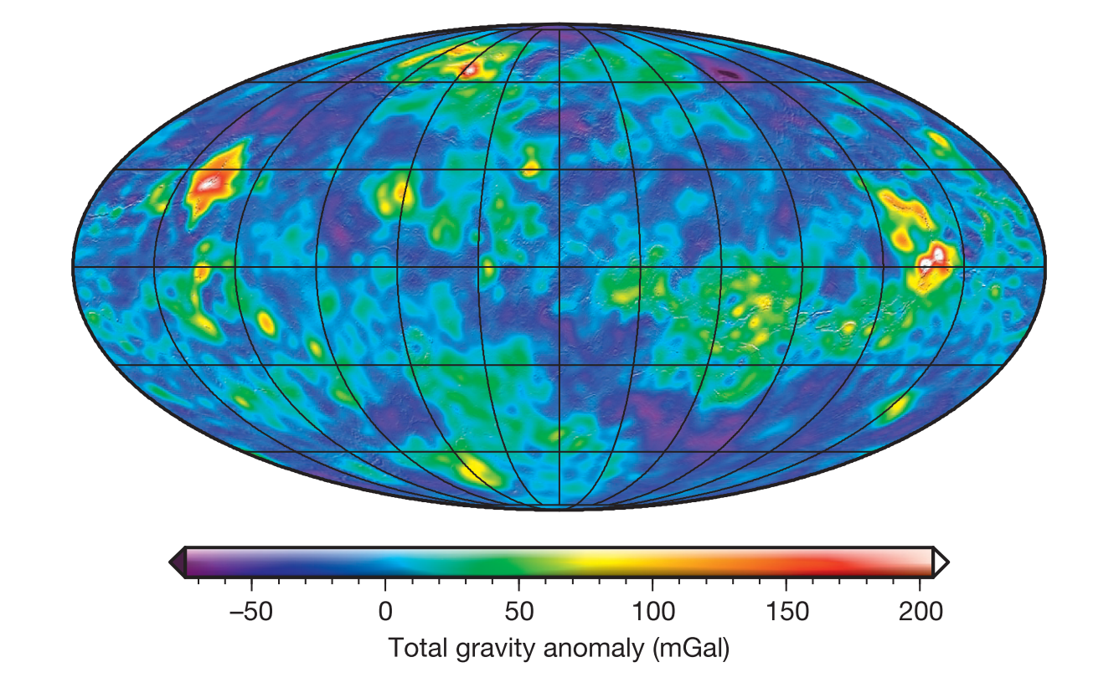
Gravity Data set
(Wieczorek et al., 2015)
Earth: Earth Gravitational Model 2008 (EGM2008) is complete up to degree and order 2159
Venus: The degree and order 180 MGNP180U data product was based on Magellan and the Pioneer Venus Orbiter data.

Slide 10
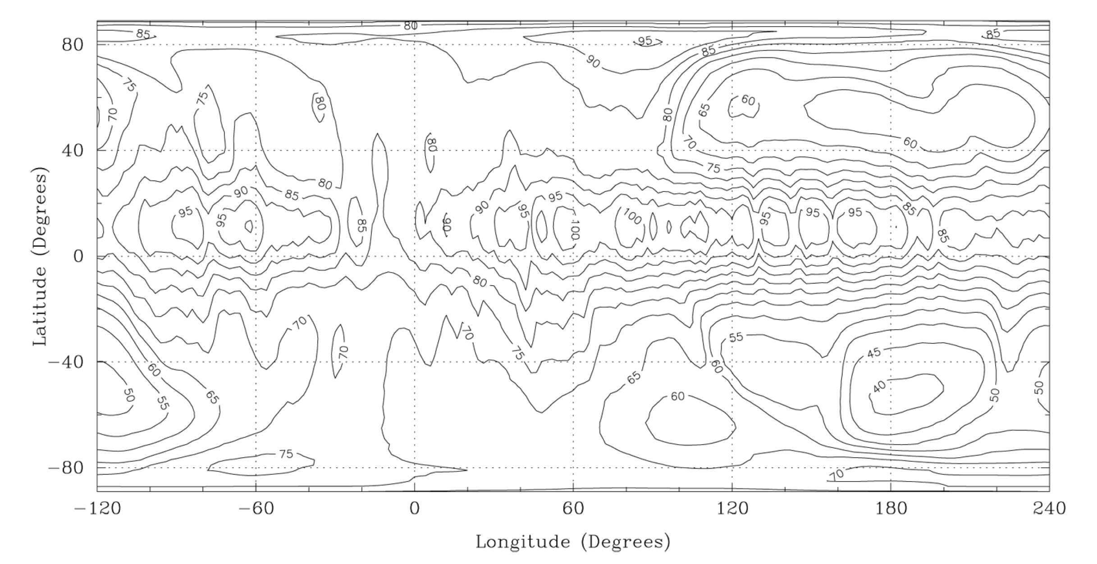
Gravity: Degree Strength
The nominal degree strength of the data set is ~70, which roughly equivalent to a resolution of a 270 km spatial block.
The degree strength of the gravity varies considerably, going from 100 near the equator to as low as 40 in some locations
(Konopliv et al., 1999)

Slide 11
Objectives & Hypotheses
The goal of this study is:
Identify subducted slabs on Venus using gravity
Test at coronae associated and unassociated with subduction
Identify parameter values at sites of subduction

Slide 12
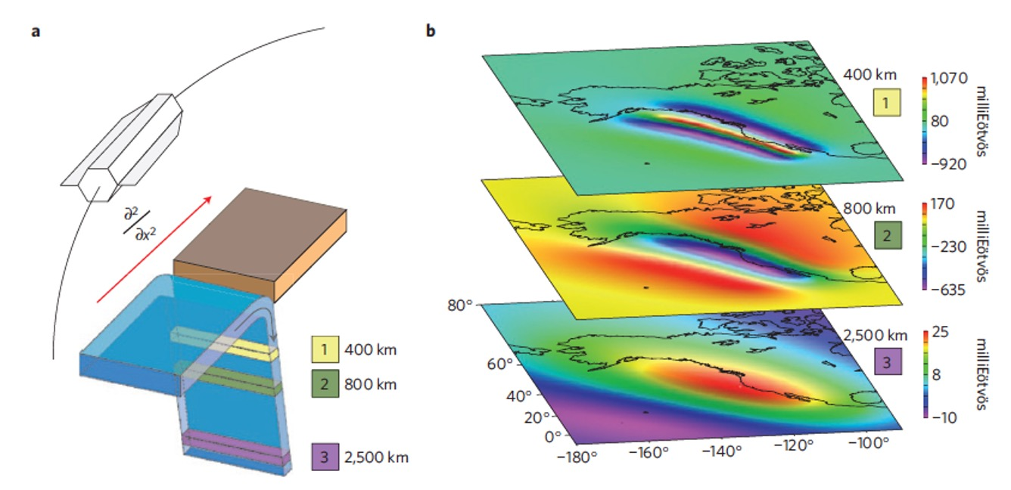
Bouguer Gravity Gradients
Topography and deep features will affect gravity
Bouguer gravity subtracts away the effects of topography.
Gravity gradients (units of Eötvös) is the rate that gravity changes over distance. This metric is more sensitive to shallower features.
(Panet et al., 2014)

Slide 13
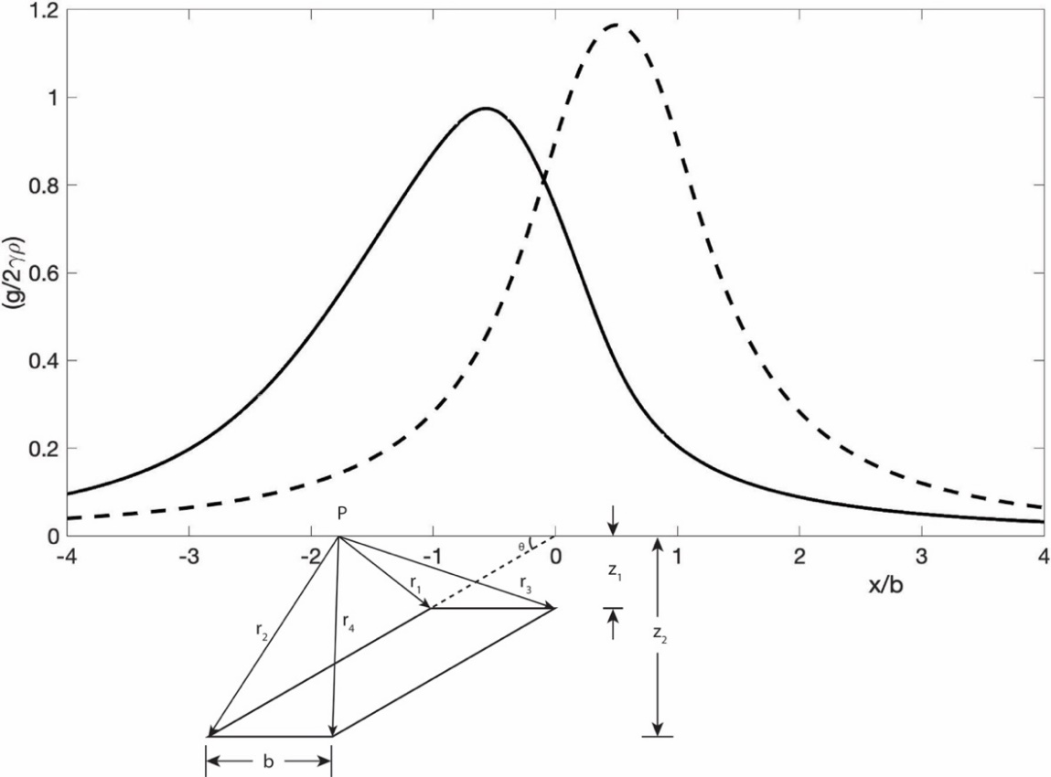
Modeled Slab Gravity: Semi-infinite prism
To build my modeled gravity from subducting slab, we start with the gravity from a semi-infinite prism.
This assumes the brown prism to go infinitely in and out of the page.
(Telford et al., 1990)

Slide 14
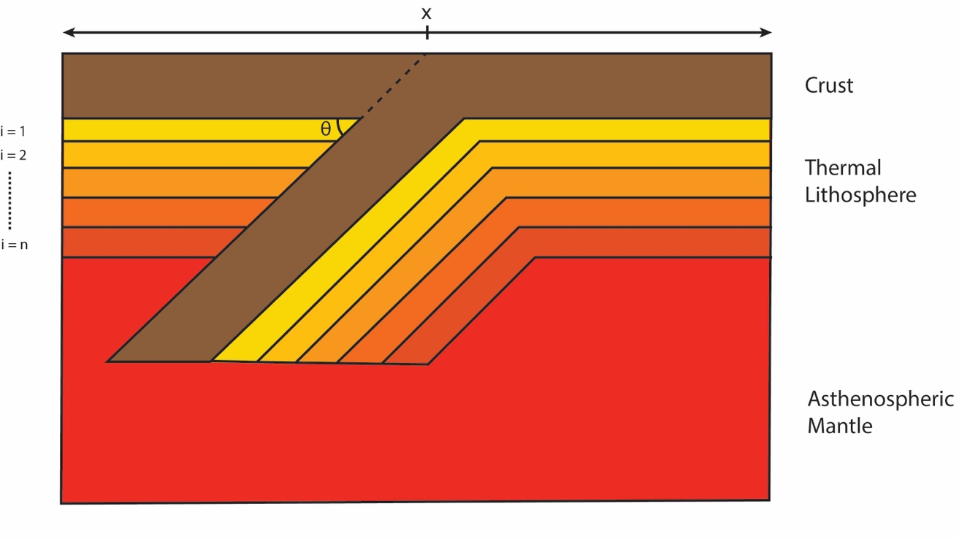
Modeled Slab Gravity: Subducting Slab Schematic
Overriding Plate
Outboard Plate
Using the gravity from a semi-infinite prism, we build this more complex schematic of subduction.
The crust and thermal lithosphere can be represented by a combination of prisms with varying densities.

Slide 15
fORWARD mODELING pARAMETERS

Slide 16
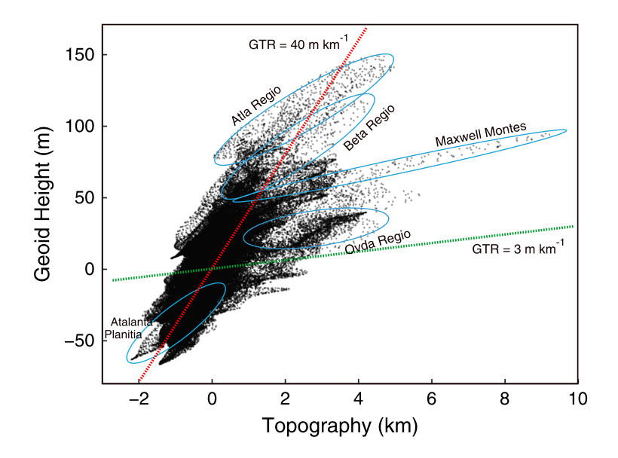
gtr
Geoid-topography ratios (GTRs) are used to estimate compensation depth and elastic thickness.
GTRs are the least squares regression of the geoid over the nearby topography.
James et al., 2013
Notes:
Geoid - Being an equipotential surface, the geoid is, by definition, a surface to which the force of gravity is everywhere perpendicular

Slide 17
High GTR
Low GTR
Dynamic Compensation:
Crustal Isostasy:
Crust
Crust
Mantle
Non-Isostatic Topography:
Mantle
- thin weak lithosphere
Crust
Mantle
- Implies a thick rigid lithosphere

Slide 18
results
Venus: Proposed Subduction
Venus: Non-subduction coronae
Terrestrial subduction

Slide 19
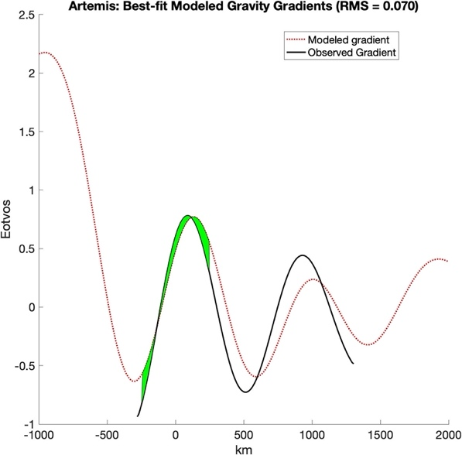
results: RMS

Slide 20
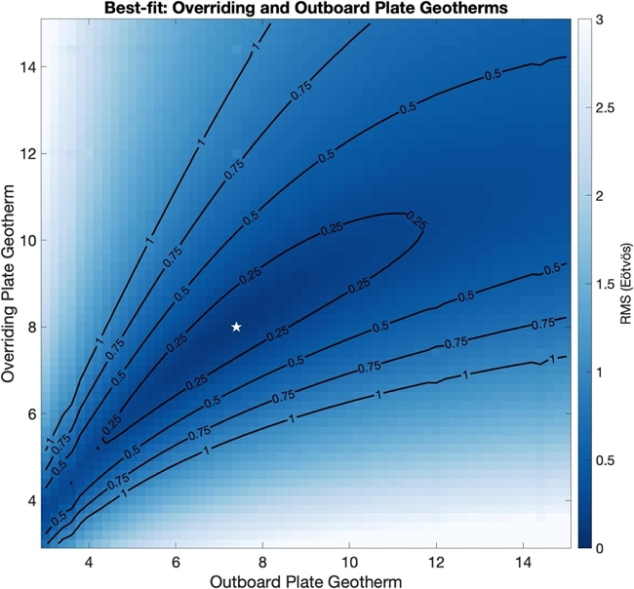
results: Geothermal Gradients

Slide 21
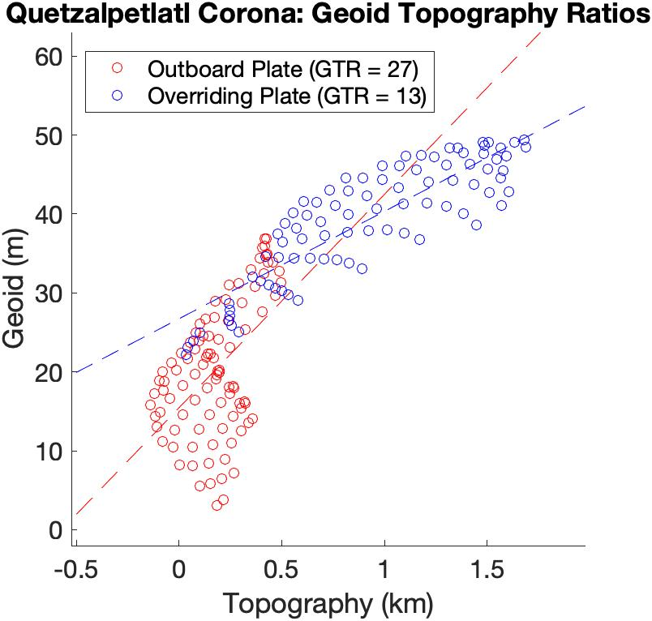
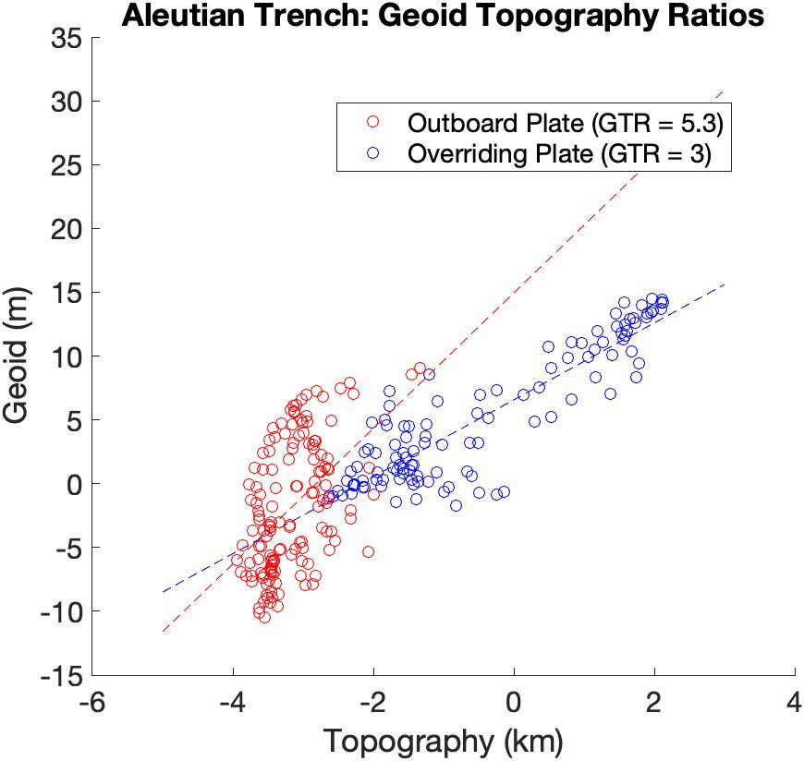
results: GTR

Slide 22
results: Average Slab Density

Slide 23
Discussions
Both the GTRs and Modeled geothermal gradients identify a trend of the subducting slab and outboard plate side being of a thicker lithosphere and smaller geothermal gradient.
The terrestrial subducting slabs are ~100 kg/ m³ denser than the surrounding mantle and the Venus subducting slabs are only ~70-90 kg/ m³ denser than the mantle. This small difference could be the reason we do not see plate tectonics and continuous subduction on Venus.

Slide 24
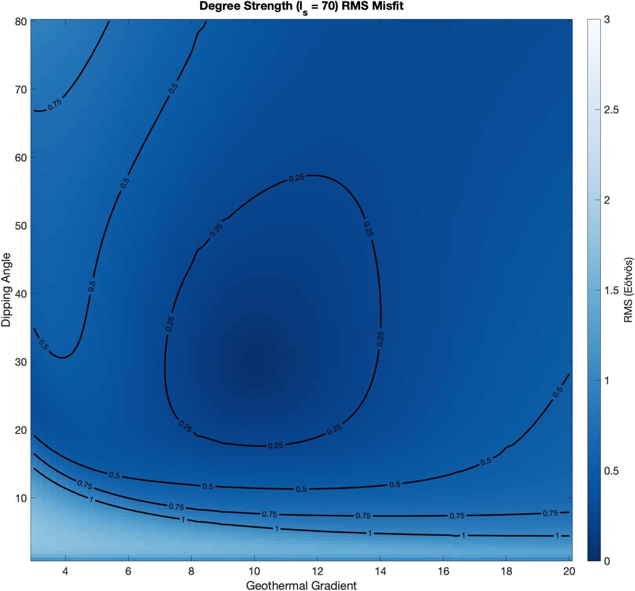
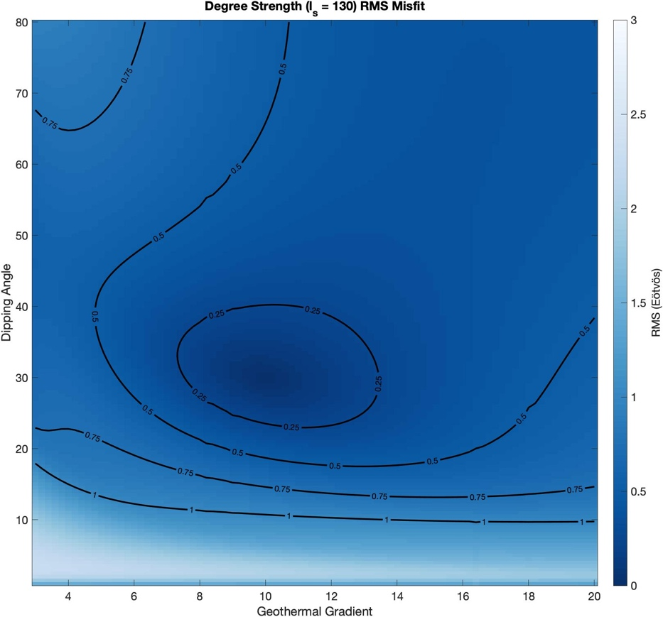
Implication for VERITAS and EnVision Missions
Improved radar mapping and gravity of Venus will give us higher resolution images, topography, gravity data, and insights into the surface composition for the locations looked at in this study and locations that were too small.

Slide 25
Conclusion
The three main take-aways:
Our modeled results are consistent with Venusian subduction at Artemis Corona, Quetzalpetlatl Corona, and Astkhik Plateau.
Observed and modeled geothermal gradients trend lower on the outboard side (i.e., thicker and colder lithosphere).
Terrestrial and Venusian subducting slabs are found to be negatively buoyant, with terrestrial slabs slightly more negatively buoyant.

Slide 26
Supplementary Slides

Slide 27
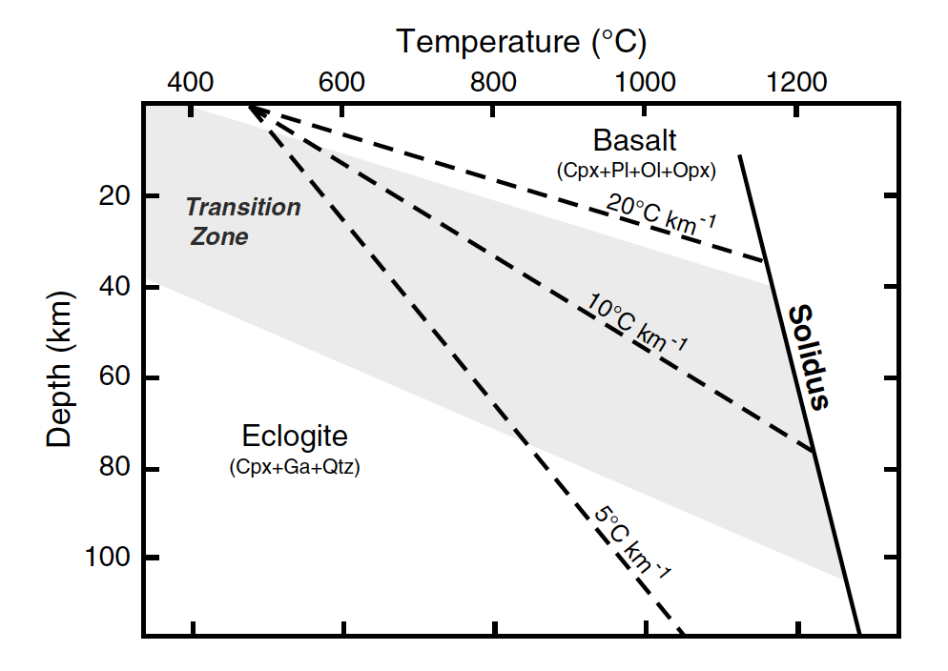
eCLOGITE
Notes:
Eclogite density – 3.45-3.75

Slide 28
Methods: GTR at subduction zones
Calculate GTRs of both sides of the Venus and terrestrial trenches
Notes:
- The difference between terrestrial and Venusian GTR ranges can be explained by the lack of a low viscosity zone on Venus

Slide 29
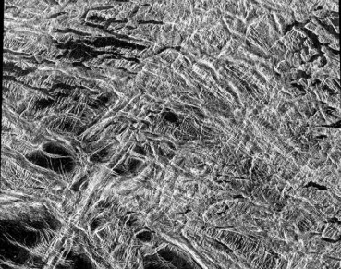
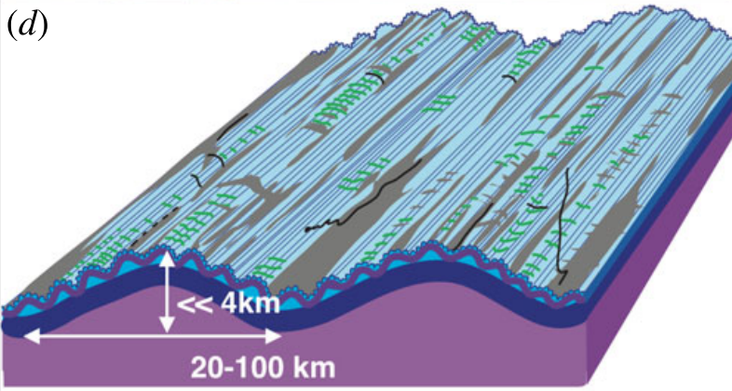
Crustal Density
Basalt (2900 kg/m³):
Based on Venera and Vega landers, the surface is assumed to be basalt
Tessera Terrain (2700-3000 kg/m³):
Highly deformed terrain found on crustal plateaus, characterized by high radar backscatter (indicating roughness from centimeter to meter scale)
Their formation is very poorly constrained and stratographically the oldest material on the planet
A felsic composition for the tessera is a possibility

Slide 30
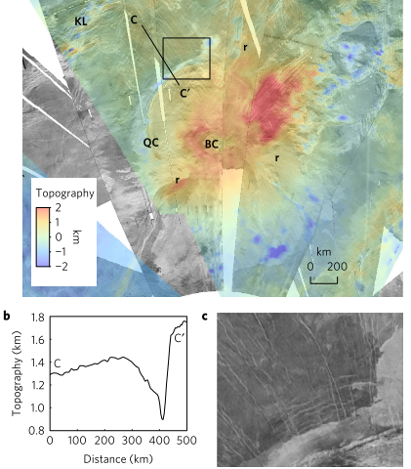
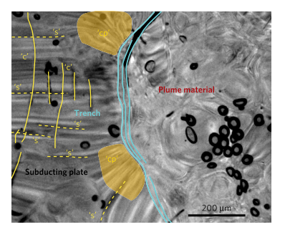
Subduction: Venus
(Davaille et al. 2017)

Slide 31
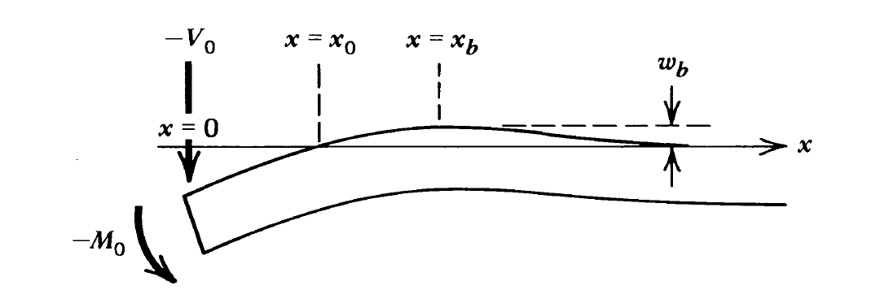
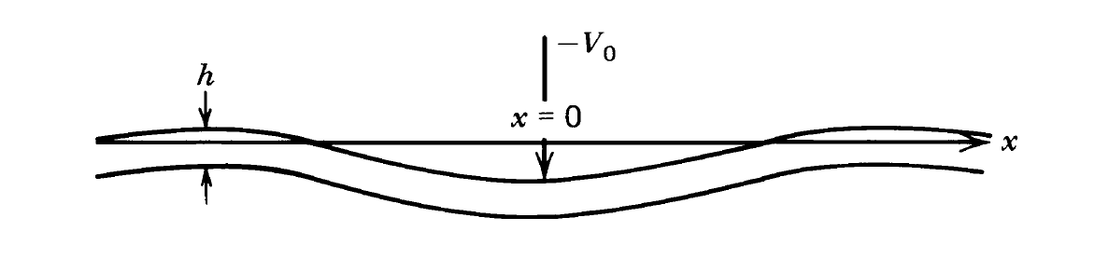
Methods: Modeling Flexural Deflection at Subduction Zones
Take gravity and topography profiles across a variety of coronae that both have and have not been associated with subduction,
Apply these two different plate flexure models to lend insight to whether subduction is occurring or not.
Broken Plate Model:
Infinite Plate model:
Turcotte & Schubert 2014

Slide 32
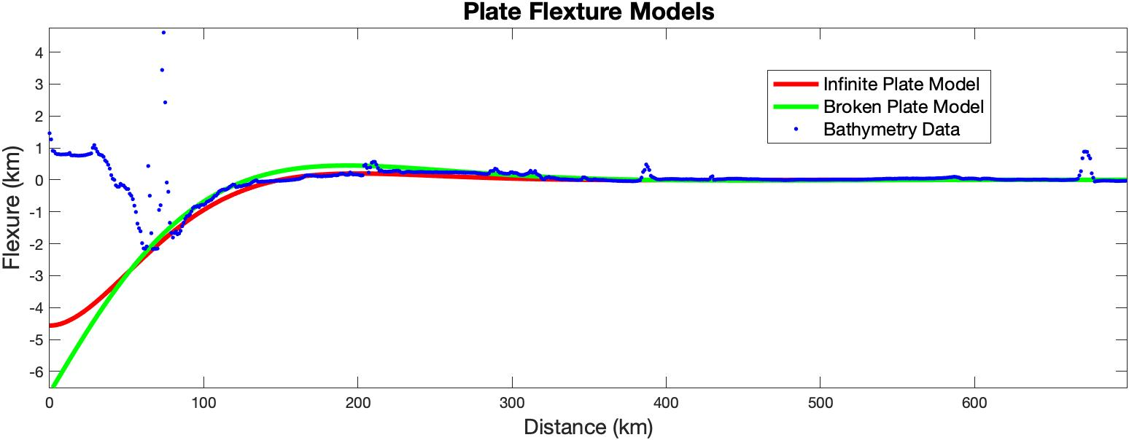
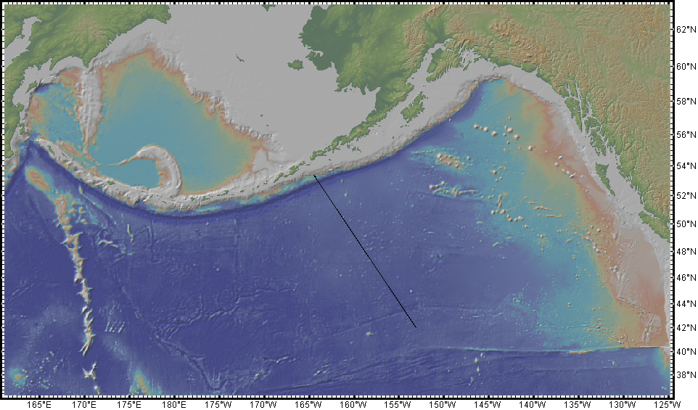
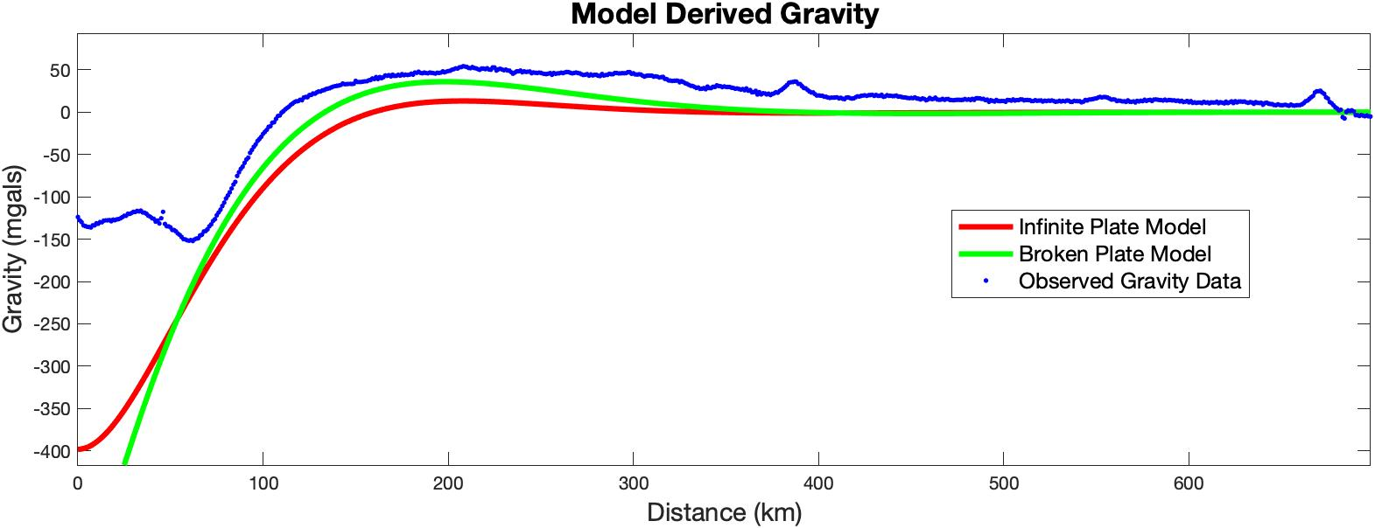
Methods: Modeling Flexural Deflection at the Aleutian trench

Slide 33
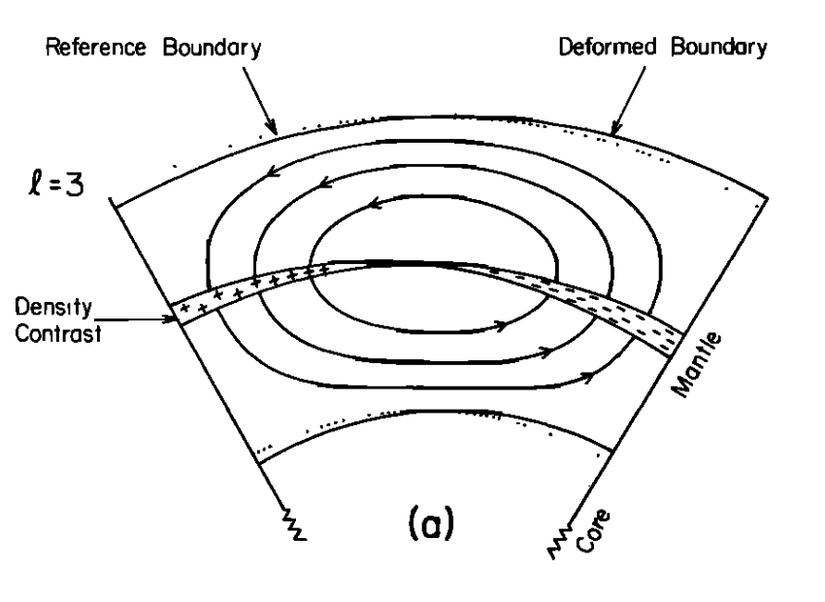
Dynamic Flow

Slide 34
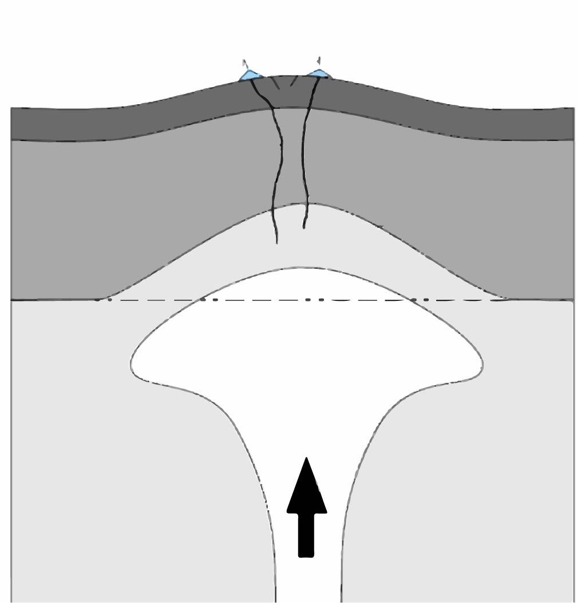
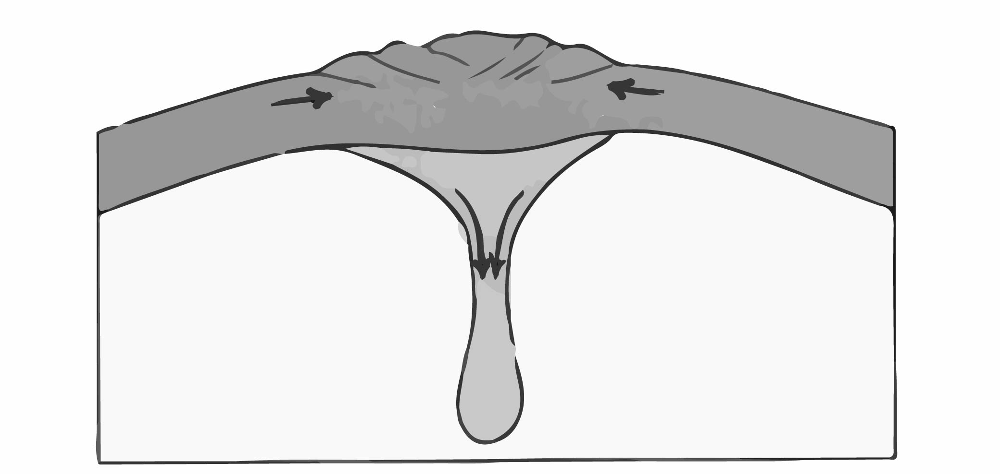
Mantle upwelling and Downwelling

